Slide 1
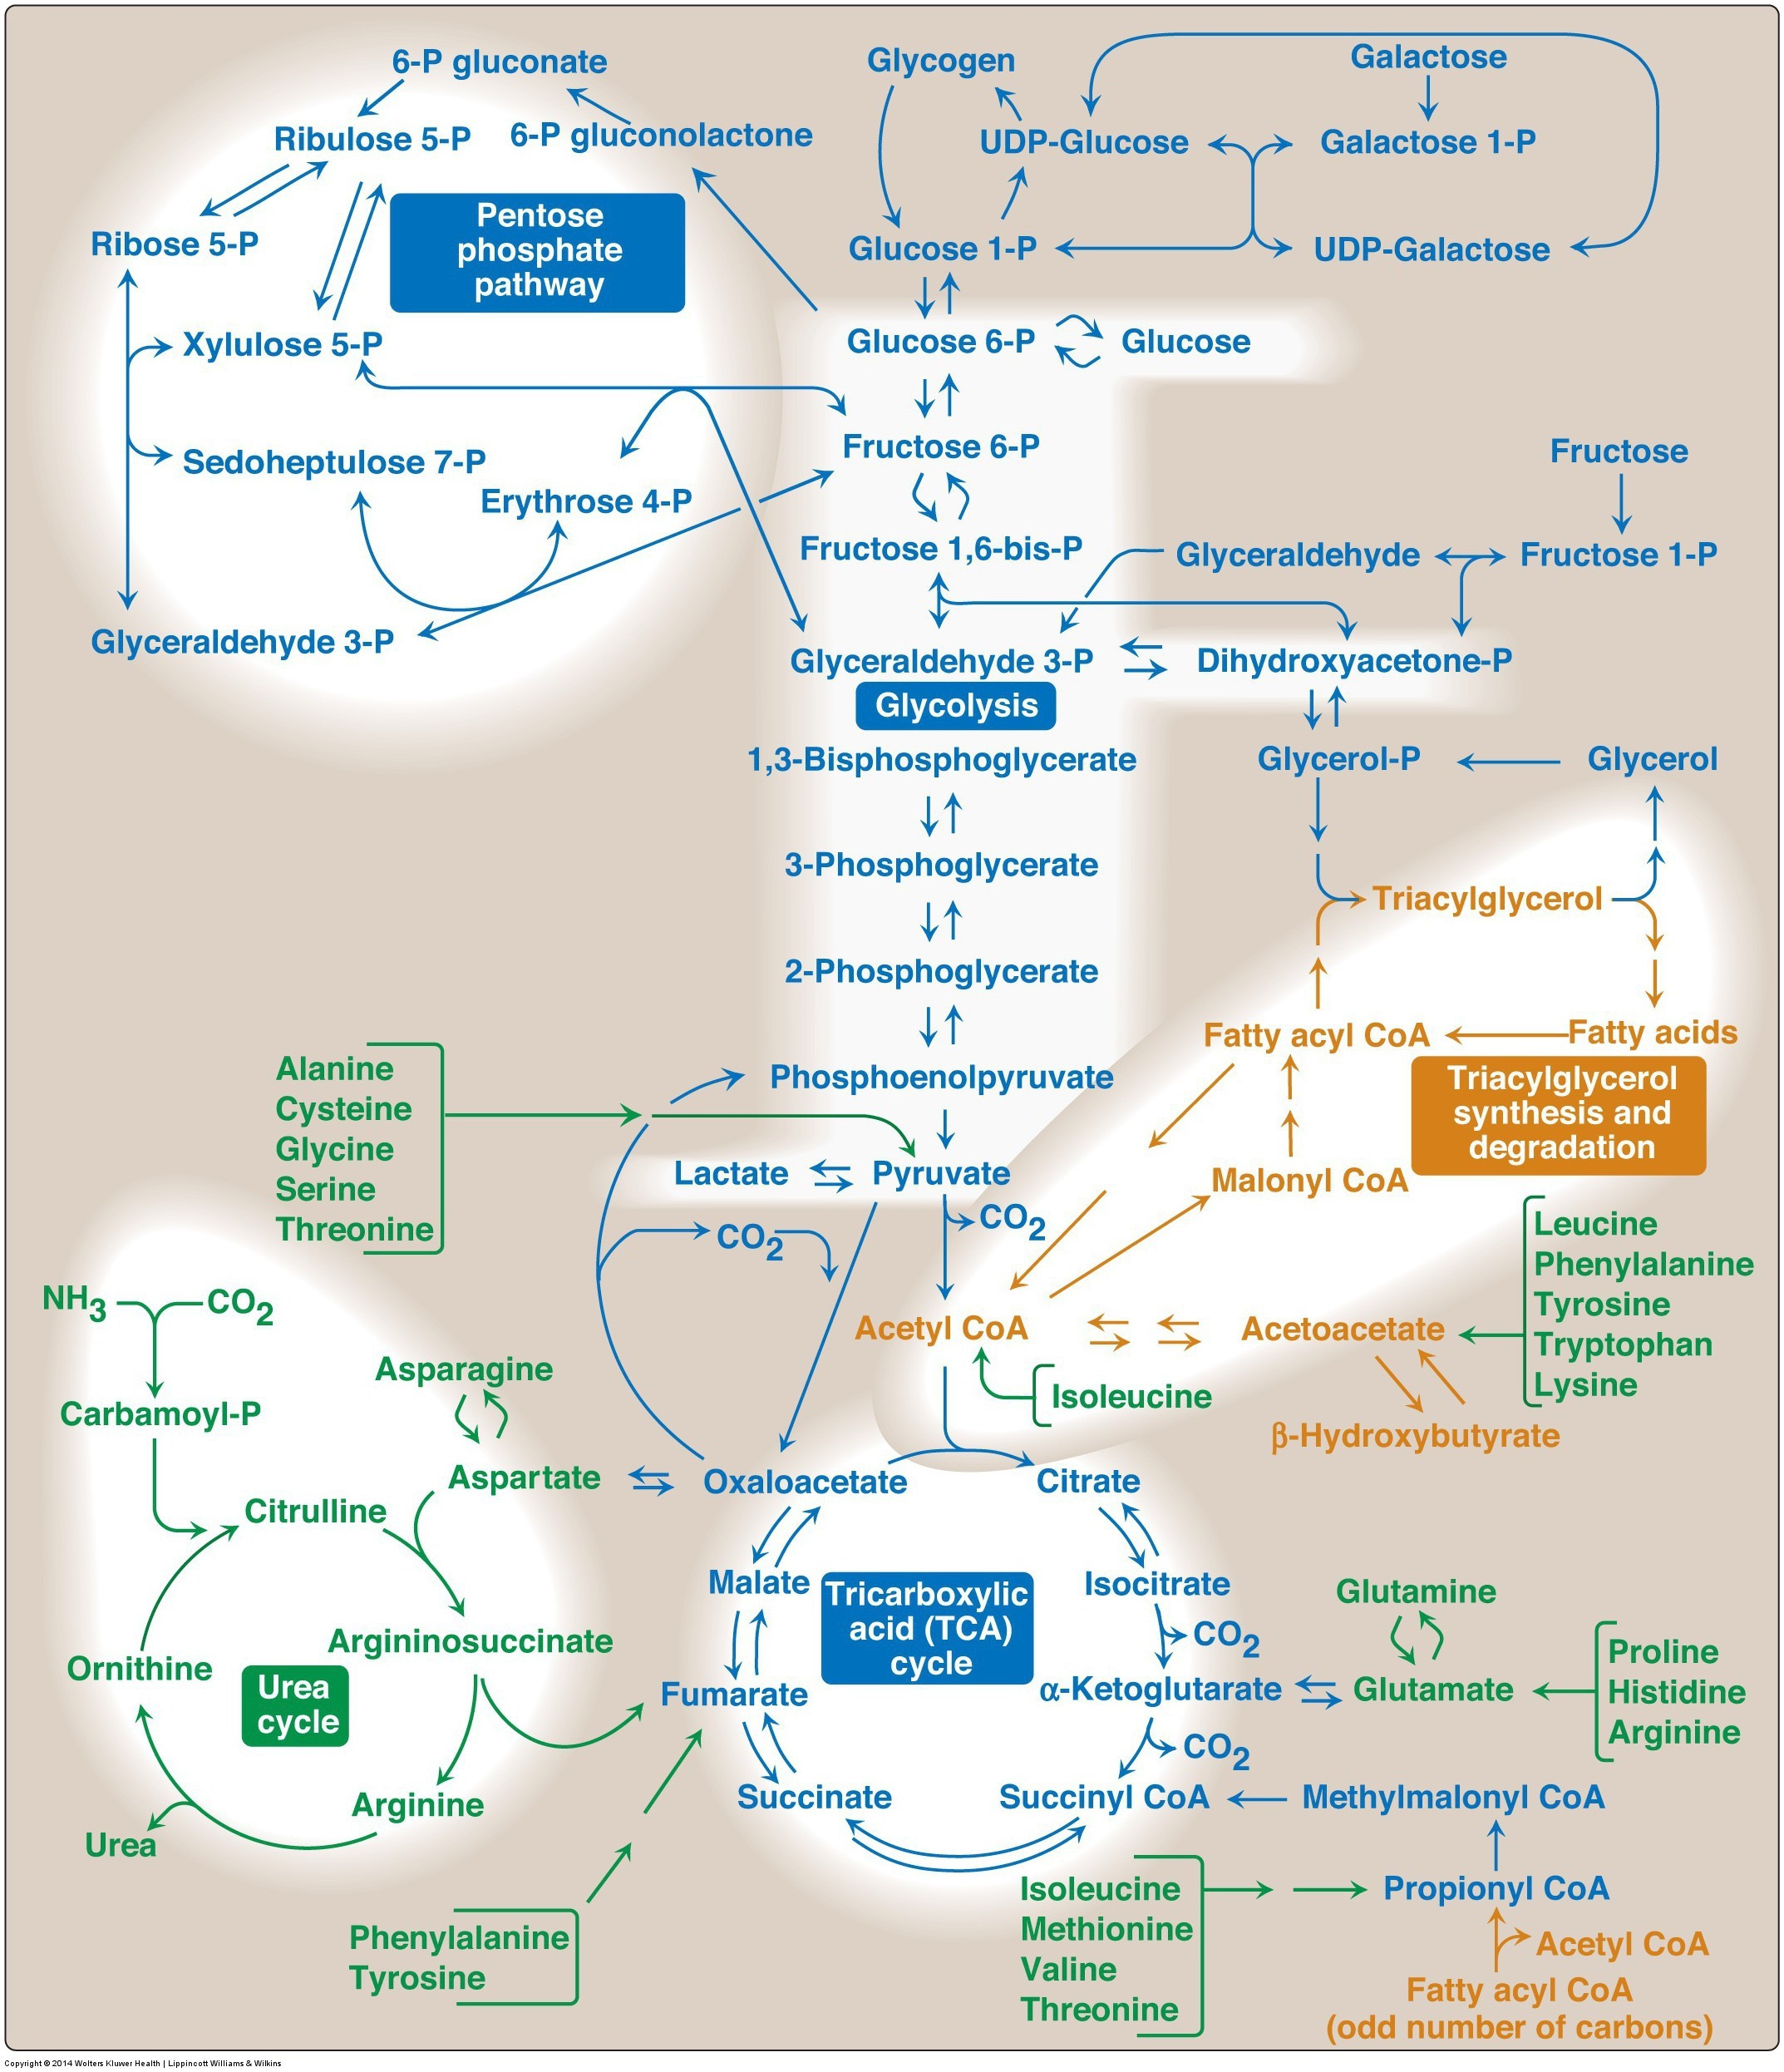
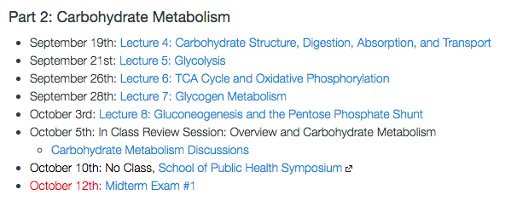
CHO Metabolism Overview

Slide 2
Glycolysis Learning Objectives
Describe the relative roles of glycolysis, gluconeogenesis, the TCA cycle as central nodes of nutrient metabolism.
Explain the catalytic differences and tissue distributions of glucokinase vs hexokinase and why this is important.
Understand how ATP is produced from glycolysis, and the efficiency of aerobic vs non-aerobic glycolysis
Understand the key points of regulation of glycolysis and how these regulatory points are controlled, notably how glucokinase/hexokinase, PFK1 and PK are regulated including what signals are important in what tissues.
Describe the potential fates of pyruvate, and what dictates the next steps in its metabolism
Explain how non-glucose carbohydrates such as galactose and fructose enter glycolysis, and how their point of entry affects how they are regulated.

Slide 3
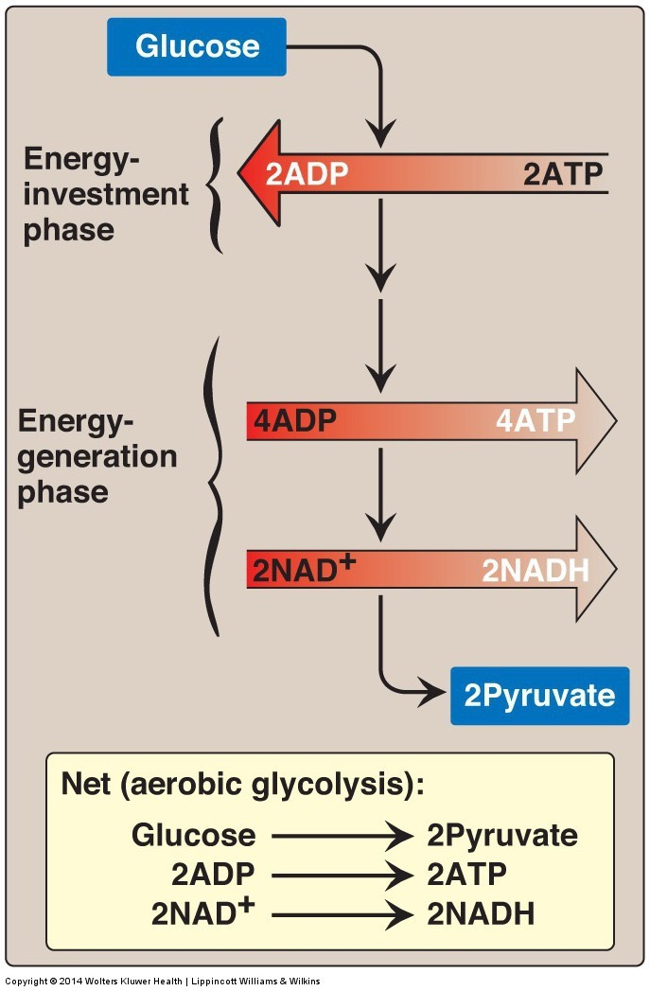
Glycolysis
Main pathway of monosaccharide degradation
Main tissue sites
Liver, muscle
Occurs in cytoplasm of the cell
Glucose conversion to two 3-carbon products: pyruvate

Slide 4
Staring with the End
End product: two pyruvates
Aerobic Conditions
Becomes Acetyl-CoA
In presence of CHO but need energy -> TCA Cycle
In presence of CHO but don’t need energy -> Lipids
In absence of CHO (relevant for lipid oxidation)
Ketone Bodies (if OAA absent)
Gluconeogenesis (if OAA present)
Anaerobic conditions
Becomes lactate
Lactate goes to liver for reconversion back to glucose
Notes:
Absent of CHO is mo

Slide 5
What is Glycolysis Accomplishing?
Think about muscle, liver and fat.
When would we want to activate or inactivate glycolysis in these tissues. Is it always the same?

Slide 6
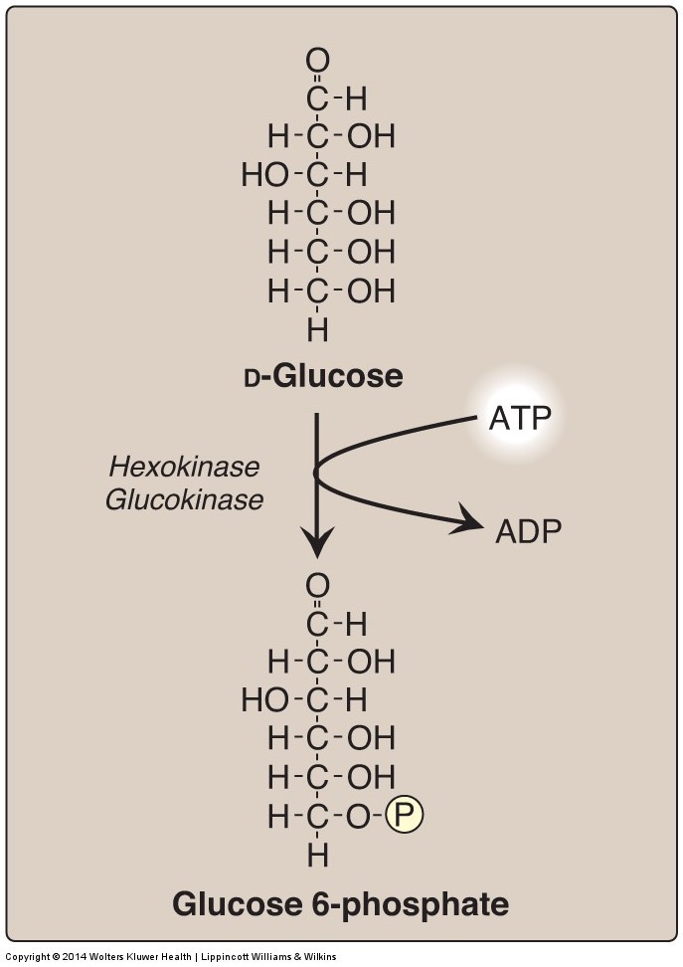
Generating Glucose-6-Phosphate
Traps glucose in the cell
Consumes ATP
Reversible by Glucose-6-Phosphatase (in liver)

Slide 7
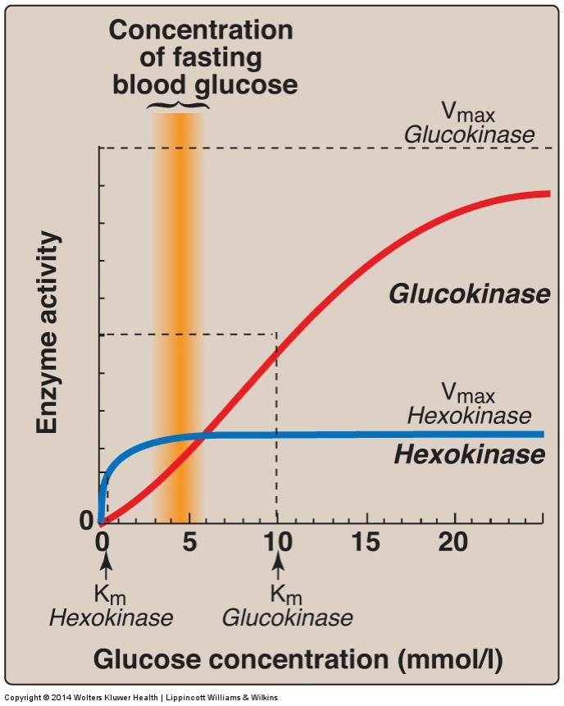
Glucokinase vs Hexokinase
Enzyme | Tissue | Regulation | Kinetics
Glucokinase | Liver/Pancreas |  | Co-operative/Fast
Hexokinase | Fat/Muscle | -G6P | High Affinity
What is the advantage of these different kinetics in these tissues?

Slide 8
Fates of Glucose-6-Phosphate
Glycogenesis
Pentose Phosphate Pathway

Slide 9
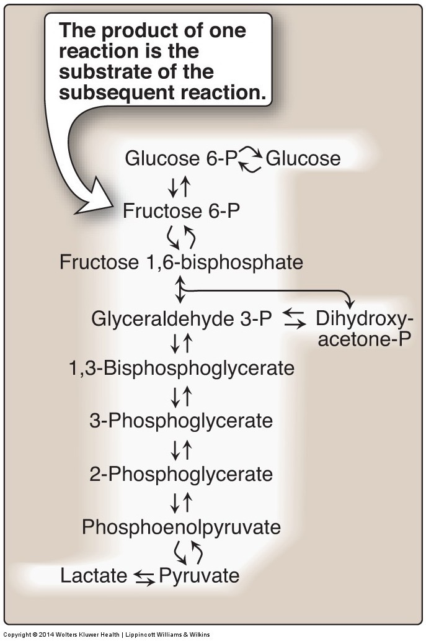
The Next Regulated Step is PFK1

Slide 10
Taurui’s Disease
Heritible loss of the PFK1 isoform in Muscle (PFKM)
Symptoms include
Muscle weakness
Increased glycogen in muscle
Myopathy
Possible treatments?

Slide 11
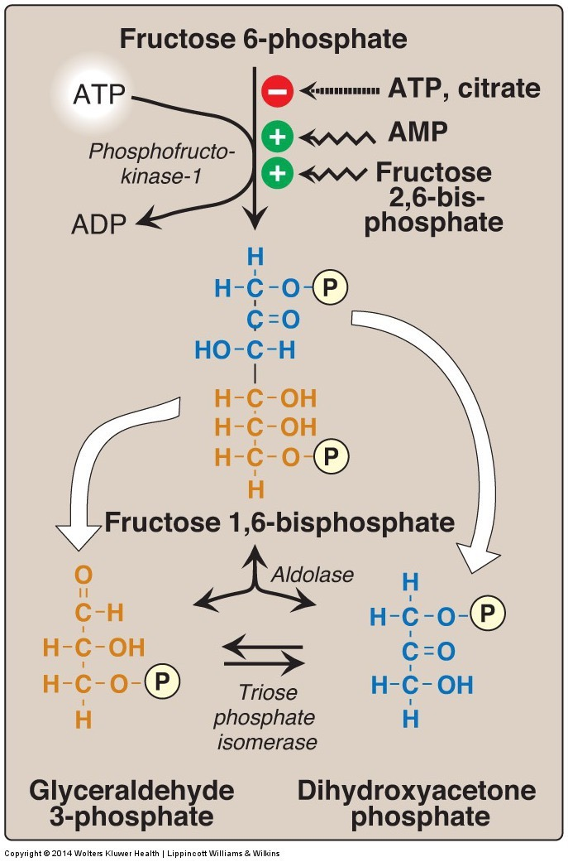
Regulation of PFK1
Priority of regulators
F26bP
AMP
ATP
Citrate

Slide 12
Allosteric Regulation of PFK1
F6P is held constant here
Mansour TE. Studies on Heart Phosphofructokinase : Studies on Heart Phosphofructokinase : Inhibition , and Activation. J. Biol. Chem. 1963;238(7):2285–2292.

Slide 13
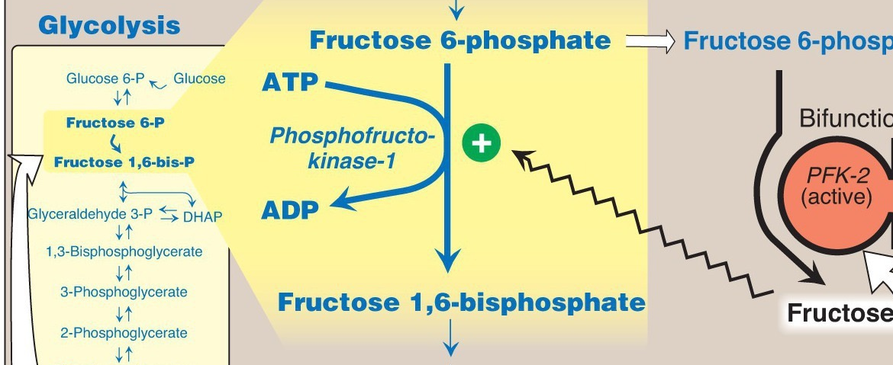
Regulating the Regulator
Fructose-2,6-bisphosphate

Slide 14
Regulating the Regulator of the Regulator

Slide 15
What is the point of all this?
Buildup of TCA cycle intermediates can slow glycolysis (Citrate)
That can be over-ridden by energy needs (ATP/AMP)
BUT glucose flux can over-ride energy needs (F26bP)
AND hormones can over-ride glucose flux (PFK2 inhibition, reducing F26bp)

Slide 16
How does glucagon/adrenaline inhibit PFK-2 activity in liver not muscle
Muscle dosen’t have PFK-2 activity
Glucagon/Adrenaline do not activate PKA in muscle
Muscle PFK-2 can’t be phosphorylated by PKA
There are no Glucagon/Adrenline receptors in muscle

Slide 17
Tissue Specificity in PFK2 Regulation
Glucagon/Adrenaline can phosphorylate and inhibit Liver PFK2 but not Muscle PFK2
PFK-2 isoforms
Pourquoi?

Slide 18
The third regulated step in glycolysis is Pyruvate Kinase
Substrate mediated ADP phosphorylation
Notes:
Other example of substrate mediated phosphorylation is phosphoglycerate kinase

Slide 19
How is Pyruvate Kinase Regulated

Slide 20
Post-Translational Regulation of Pyruvate Kinase
Alanine inhibition only in liver

Slide 21
What would PFK2 deficiency do to Pyruvate Kinase Activity
Increase it because of less Fructose-1,6-bisphosphate
Decrease it because of less Fructose-1,6-bisphosphate
Increase it because of less Fructose-2,6-bisphosphate
Decrease it because of less Fructose-2,6-bisphosphate

Slide 22
Tissue Specific Regulation of PK
Component | Liver | Muscle
Glucokinase/Hexokinase | Not inhibited by G6P | Inhibited by G6P
Phosphofructokinase | Inhibition of PFK-2 (regulates via F26bP) | PFK-2 not inhibited by phosphorylation
Pyruvate Kinase | Inhibition of PK by alanine and by phosphorylation | PK not inhibited by alanine or phosphorylation

Slide 23
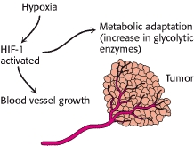
Transcriptional Regulation of GK/HK, PFK1 and PK Promotes Glycolysis
Hypoxia (HIF)
Carbohydrate sensing (ChREBP)
Chronic glucagon (CREB)

Slide 24
Glycolysis Net ATP
Note: NADH is energy equivalent to 3 ATP (from the ETC)
Energy Consuming Reactions:
Reactions 1: 1 ATP
Reaction 3: 1 ATP
Energy Generating Reactions:
Reaction 6: 1 NADH x 2 (3 ATP x 2 = 6 ATP)
Reaction 7: 1 ATP x 2 (2 ATP)
Reaction 10: 1 ATP x 2 (2 ATP)
Net Energy Gain:
4 ATP + 2 NADH minus 2 ATP = 8 ATP generated from glycolytic breakdown of glucose

Slide 25
TCA Cycle Net ATP

Slide 26
Fructose and Galactose

Slide 27
Liver Fructose Metabolism
5
Skips the regulatory steps of Glucokinase and PFK2

Slide 28
Fructose Consumption and Metabolic Health

Slide 29
Two Inherited Fructose Metabolism
Fructokinase mutations
Fructose not trapped in the cell
Elevated fructose in the blood
Generally not pathological
Aldolase B mutations
Buildup of Fructose-1-phosphate
Impaired gluconeogenesis and glycogenolysis
High risk of hypoglycemia
What if fructokinase made Fructose-6-phosphate (it dosent)? How would that affect glycolysis?

Slide 30
Fructolysis Summary
Fructose glycolysis in liver begins with FK
Bypasses two important regulatory step in glycolysis
Reaction 1 (glucokinase/hexokinase)
Reaction 3 (phosphofructokinase)
Pyruvate products may be shifted to pathways involved in fatty acid or cholesterol synthesis
Outside the liver hexokinase can phosphorylate Fructose to make F6P, but this is very inefficient

Slide 31
Galactolysis
Galactokinase
(Liver)
Galactose
Galactose 1-Phosphate
UDP-glucose + galactose 1-phosphate uridylydtransferase
ATP
ADP
Phospho-glucomutase
Glucose 6-Phosphate
Glucose 1-Phosphate
Glycogen
Metabolism
Pyruvate (glycolysis)

Slide 32
Glycolysis (Galactose) Summary
Galactose kinase phosphorylates galactose to galactose 1-phosphate
Galactose 1-P is coverted to Glucose 1-phosphate
G1P has different fates dependent on energy needs:
Glycogenesis
Glycolysis

Slide 33
Glycolysis Learning Objectives
Describe the relative roles of glycolysis, gluconeogenesis, the TCA cycle as central nodes of nutrient metabolism.
Explain the catalytic differences and tissue distributions of glucokinase vs hexokinase and why this is important.
Understand how ATP is produced from glycolysis, and the efficiency of aerobic vs non-aerobic glycolysis
Understand the key points of regulation of glycolysis and how these regulatory points are controlled, notably how glucokinase/hexokinase, PFK1 and PK are regulated including what signals are important in what tissues.
Describe the potential fates of pyruvate, and what dictates the next steps in its metabolism
Explain how non-glucose carbohydrates such as galactose and fructose enter glycolysis, and how their point of entry affects how they are regulated.

